Slide 1
Honors 101: Campus Trees Survey

Slide 2
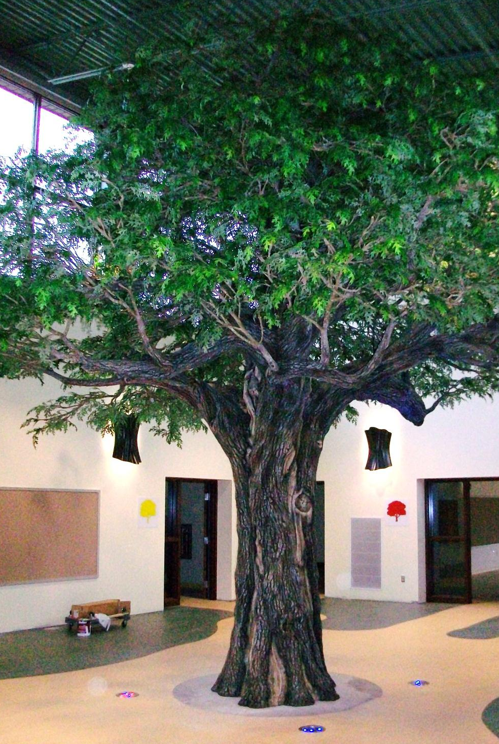

Slide 3
Sustainability Education
safe exposure to nature
select the right students, interests, & abilities
value students with credits & your time
be prepared & be patient
explicit reflection on learning & ethics

Slide 4
i-Tree:
The Honors Colloquium sampled the campus trees using a National Forest Service database software package to estimate:
forest cover,
[allergen production],
carbon storage,
energy savings, &
risk from major pests.

Slide 5
UFORE:
Nowak, David J., Crane, Daniel E. (USFS, NRS) & McHale, Patrick (SUNY-ESF).
The results we hoped for were:
age, health, & diversity,
allergen production,
carbon storage & annual carbon sequestration,
particulate matter removal rate, &
building energy conservation amounts.
i-Tree’s Urban FORest Effects model has five components:
Anatomy / structure,
Biogenic VOC emissions,
Carbon storage & sequestration,
Dry pollution deposition, &
Energy conservation.

Slide 6
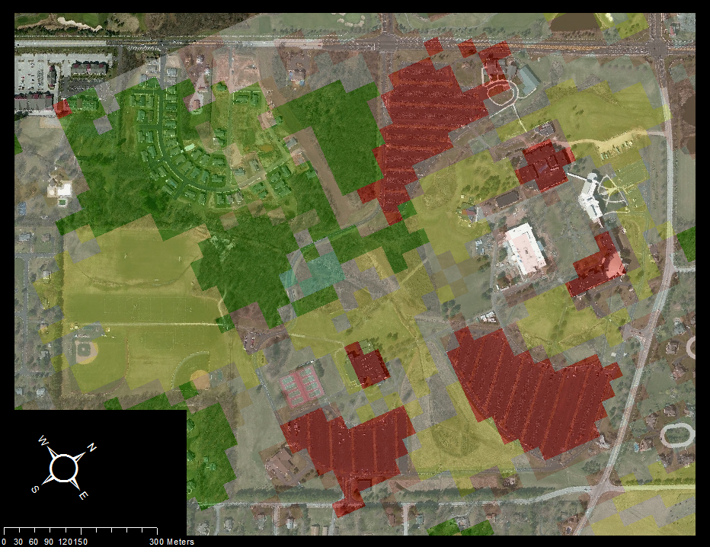
LandSat analysis of ground cover was obtained so UFORE could apply the sampled trees and ground cover to the entire campus. This became the basis for our structured random sampling, as well.

Slide 7
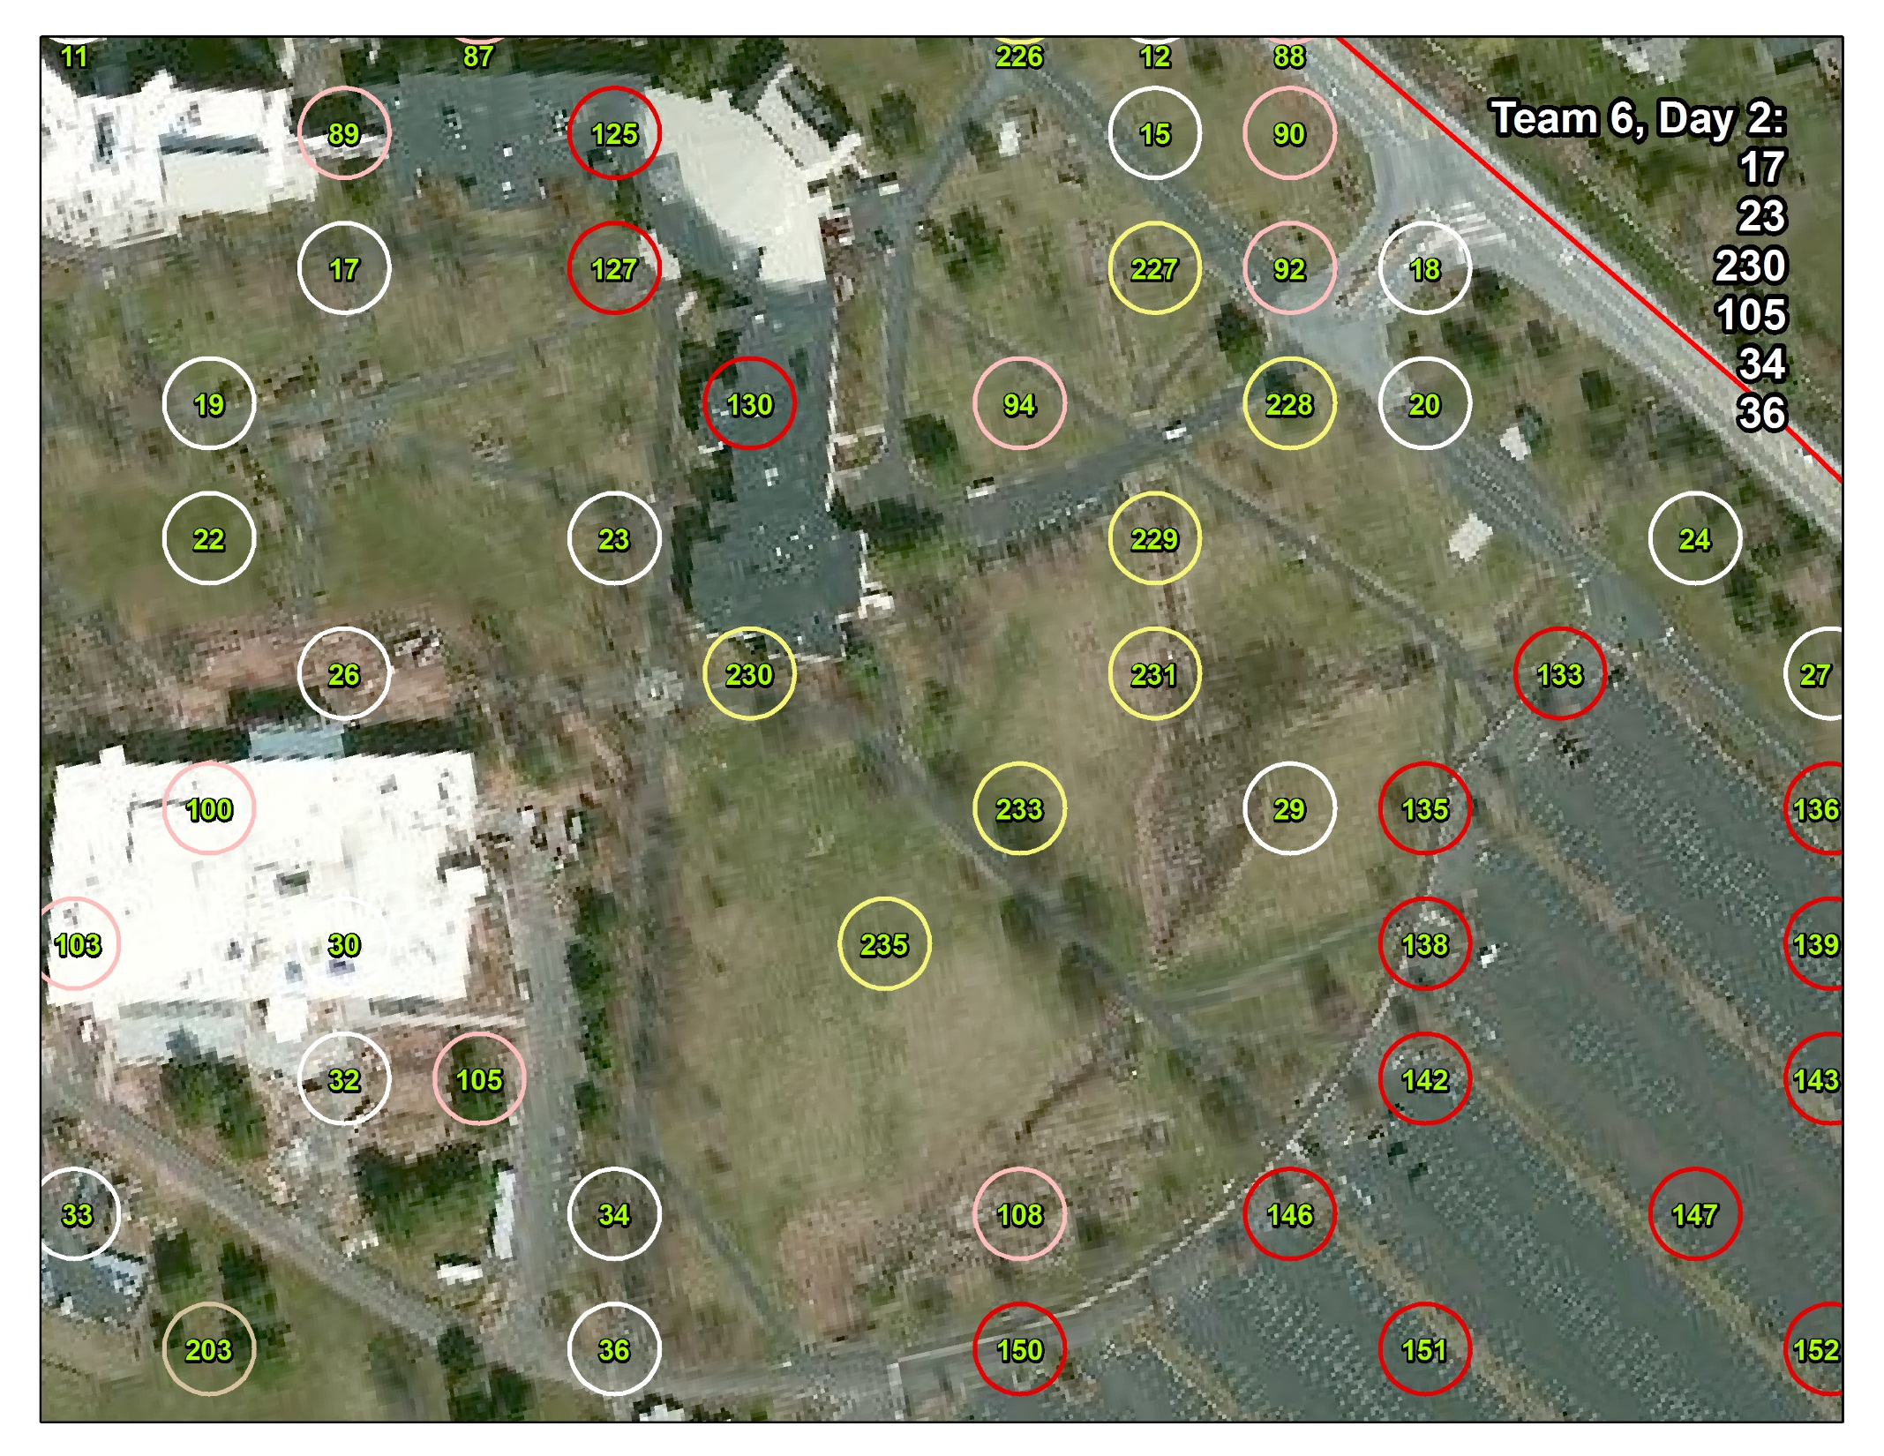

Slide 8
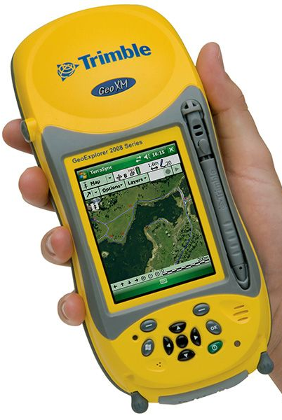
The participants used handheld field computers to record sample data with the i-Tree software.
It was then uploaded to the National Forest Service UFORE database for analysis.
Results were returned in text and graphics.

Slide 9
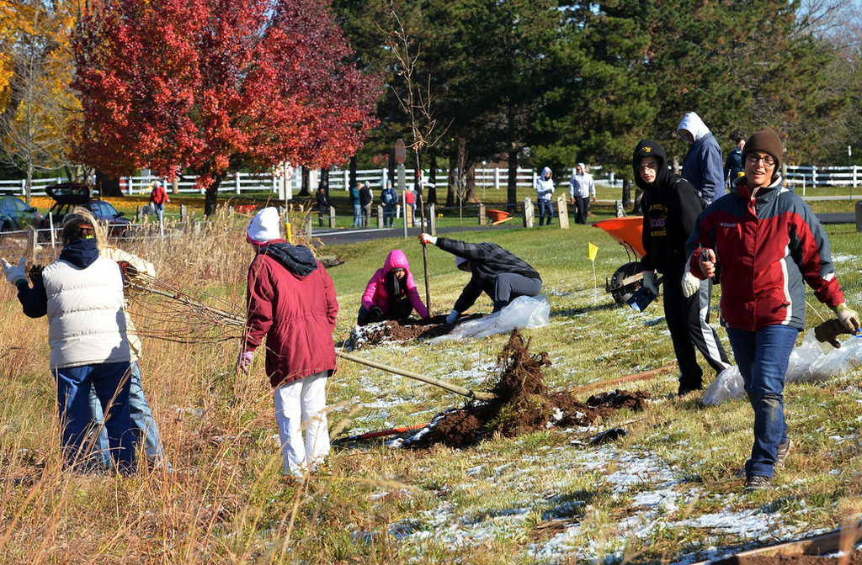
Geoff Patton for The Reporter 11/17/14

Slide 10
Samuel Clay Wallace Dr. Jerry Coleman
Assistant Geography Professor Assistant Biology Professor
Honors 101 Colloquium:
“Campus Trees Survey”
William Bianco
Sean Bradley
Christie Christ
Kevin Clark
Maggie Crush
Natalya Martin
Mae Morelos
Mari Morelos
Hayme Morelos
Lindsey Norward
Marina Resendiz
Anthony Tartaglia
Rachael Tashjian

